Slide 1

Express.js Fundamentals
Course Introduction
SoftUni Team
Technical Trainers
Software University
https://softuni.bg/

Slide 2
Table of Contents
Module Overview
Course Objectives
Training and Team
Course Organization
Evaluation Criteria

Slide 3
Have a Question?
sli.do
#js-web

Slide 4












SoftUni Diamond Partners

Slide 5




SoftUni Organizational Partners

Slide 6



JS Web
Module Overview

Slide 7
JS Web Module Goals
3 months intensive JavaScript framework training
4 times weekly, lots of live coding, homework and projects
Part I – Express.js
Node.js, MongoDB, Express.js Web Server
Part II – React.js
React basics, JSX, Components, Redux connection
Part III – Angular
Angular CLI, TypeScript, Services, DI, Directives, Redux

Slide 8
JS Web Module – Timeline
14-Jan-2019
11-Feb-2019
18-Mar-2019
Express.js
4 weeks * 4 times / week
8 credits
Start: 14-Jan-2019
Final exam: 10-Feb-2019
React.js
4 weeks * 4 times / week
8 credits
Start: 11-Feb-2019
Project Defense: 17-Mar-2019
Angular
4 weeks * 4 times / week
8 credits
Start: 18-Mar-2019
Project Defense: 21-Apr-2019
Re-Take Exams
Express – 19 Apr
React – 23 Apr
Angular – 25 Apr

Slide 9

Course Objectives

Slide 10
Course Objectives
Extend the skills, gained in JS Core, by introducing server-side JavaScript technologies
Learn to use the most common techniques in web development
Apply the fundamentals of application architecture and code convention through the MVC pattern
Requirements
HTML & JS (ES 2016) coding skills – intermediate level
Computer English – entry level

Slide 11

Course Topics
Introduction to HTTP and Node.js
Node Web Server and Utilities
Persistence – Files and MongoDB
Intro to Express.js & View Engines
Session & Authentication
Architecture & Code Styling
Workshop: Building a REST API

Slide 12
Exam
Link to last Express.js Exam: https://judge.softuni.bg/Contests/1070/ExpressJS-17-Jun-2018-Exam
Structure: Server-Side Rendering App for 6 hours
Implement CRUD operations + login / register / logout
Use Express.js + Handlebars and MongoDB
Optionally:
Use MVC architecture

Slide 13

Exam Demonstration

Slide 14

The Team

Slide 15
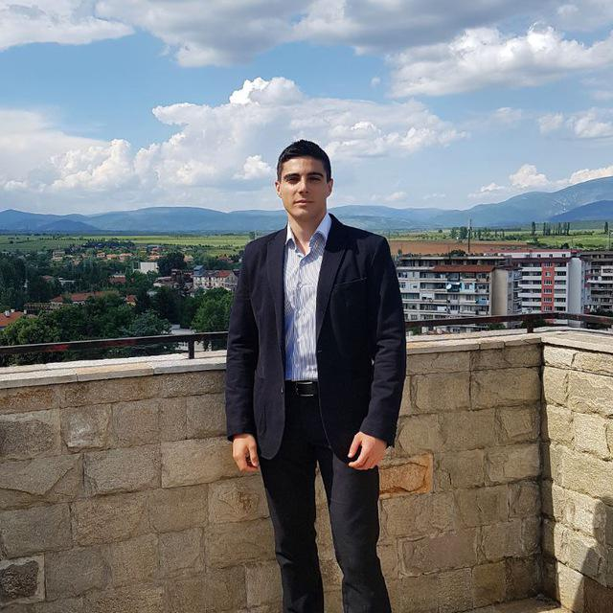
William Abboud
Full Stack & Senior Front-End Developer @ SoftUni
Studied Computer Science in Newcastle University
Passionate about Front-End Technologies (HTML/CSS/JS/React.js) and UX/UI Design

Slide 16

Ivaylo Dimitrov
Technical Trainer in Software University
4+ years experience in the IT (HTML, CSS, JavaScript, C#, SQL, Windows Server)
Excellent Software University student

Slide 17

Course Organization

Slide 18

Homework Assignments & Exercises
Your homework is mainly work in class
Lesson days → slides + live demos
Exercise days → only exercises
How to submit your homework?
Submitted in softuni.bg
Do your homework when it's due
Assignments pile up quickly

Slide 19


Scoring System for the Course
Mandatory:
Final exam – 90%
Exercises & homework – 10%
Bonuses:
Presence in class – 5% bonus
Forum activity – bonus up to 5%

Slide 20



Course Web Site, Forum and FB Group
Official web site:
Official discussion forum:
Official Facebook group:
softuni.bg/courses/express-js-fundamentals
softuni.bg/forum/categories/107/
facebook.com/groups/JSWebJanuary2019/

Slide 21
https://softuni.bg/courses/express-js-fundamentals

Slide 22




Trainings @ Software University (SoftUni)
Software University – High-Quality Education and Employment Opportunities
softuni.bg
Software University Foundation
http://softuni.foundation/
Software University @ Facebook
facebook.com/SoftwareUniversity
Software University Forums
forum.softuni.bg

Slide 23

License
This course (slides, examples, demos, videos, homework, etc.) is licensed under the "Creative Commons Attribution-NonCommercial-ShareAlike 4.0 International" license

